Slide 1
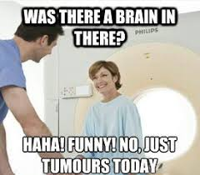
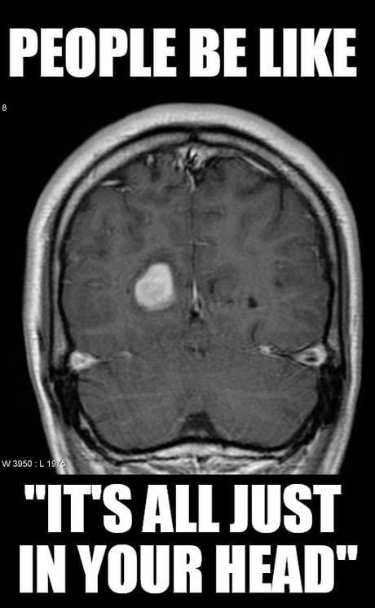
MIE1517 Final Project
Deep Learning-Based Brain Tumor Classification Using MRI Images
Team 2
Amine Mazouzi, Basak Kaya, Calise Moldawa, Haisu Wang
Notes:
Hello Everyone! For our final project, we developed a deep learning model to classify brain tumors from MRI images.

Slide 2

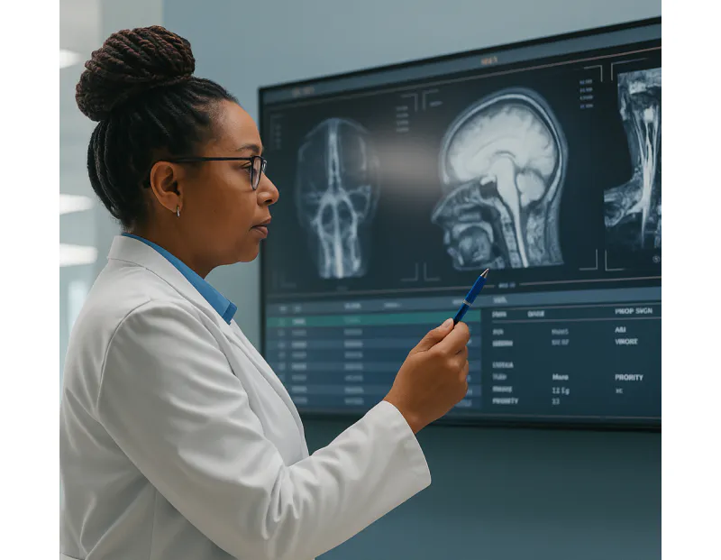
Problem
Context: Radiologists today face unprecedented workloads:
Global imaging volume has increased by over 300% in the past two decades
Radiologist may review up to 20,000 imaging studies per year.
Objective: Build an AI model that can detect the type of Brain tumor from a MRI scan
Why AI Matters for MRI Brain Tumor Diagnosis?
Reduce radiologist workload and speed up detection
Provide more consistent and accessible medical image interpretation
Help regions with limited access to highly trained specialists
Notes:
In fact, imaging volumes have surged by over 300% in the last two decades, leaving radiologists overwhelmed with up to 20,000 studies a year. Our goal is to develop an AI model that automatically identifies brain tumor types from MRI scans. This can reduce workload, speed up detection, improve consistency, and extend high-quality diagnostic support to regions with limited specialist access.

Slide 3
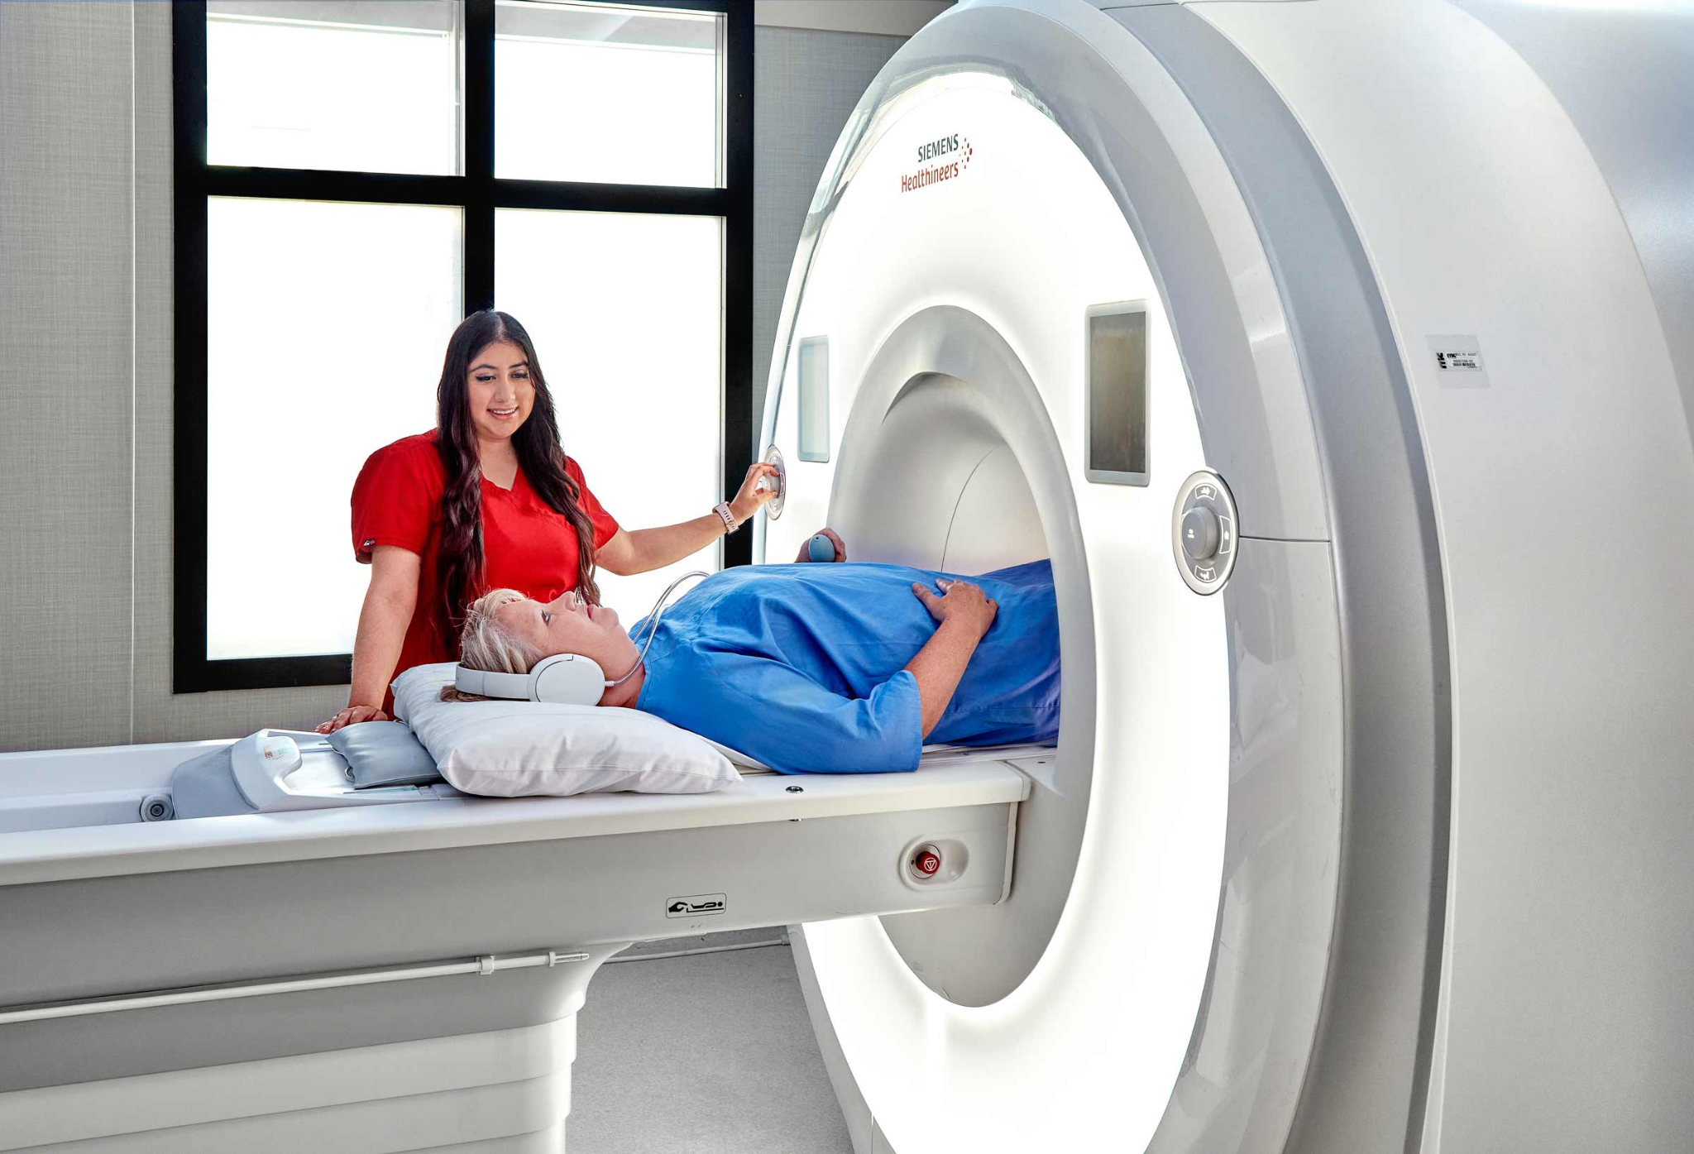
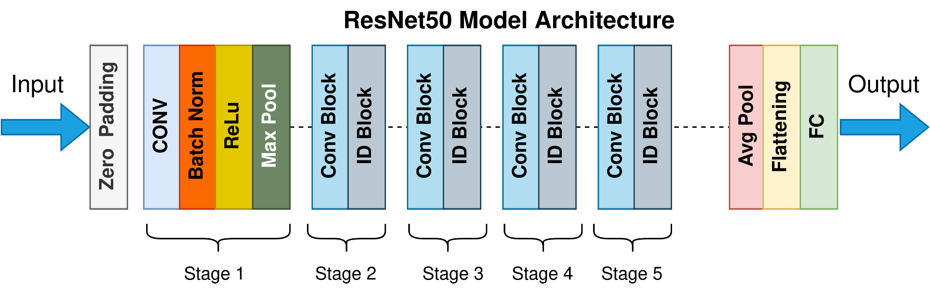
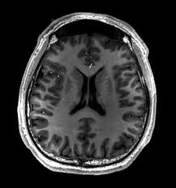
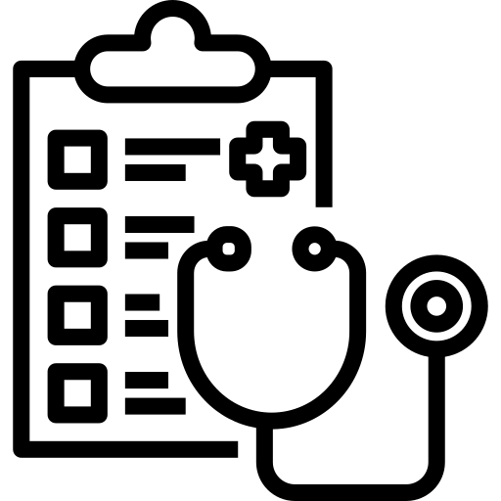
Demonstration
Diagnosis
Notes:
This is a demonstration of how our AI model will work.

Slide 4
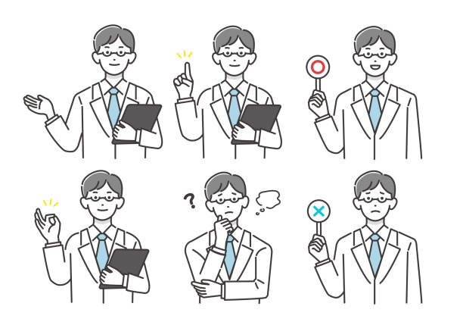
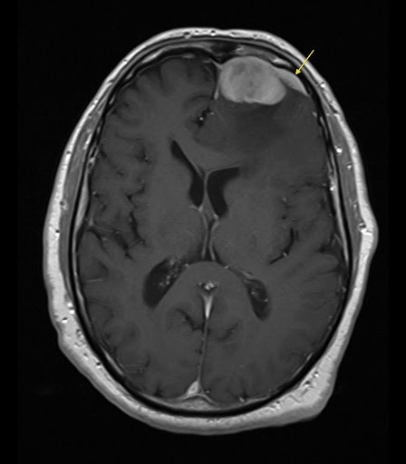
Demonstration
Captured MRI image
ResNet-50
Model
Diagnosis
Notes:
Firstly, the doctor will take a MRI scan of the brain.

Slide 5

Demonstration
Captured MRI image
ResNet-50
Model
Diagnosis
Notes:
Then, our deep learning model will analyse it.

Slide 6
Demonstration
Captured MRI image
ResNet-50
Model
Diagnosis:
Meningioma
Notes:
Finally, a diagnosis, approved by the doctor, will be made. Here’s an example of several tumor detections.

Slide 7
End-to-End Pipeline
Training Phase
Input Data(Kaggle Data Set: 7023 MRI Images)
Resize all images to
224 x 224
Split the dataset by 80/20 train/val
Fine Tune Pretrained ResNet-50
(Transfer learning)
Note: ResNet-50 has 50 layers with learnable weights.
Notes:
How does our pipeline work? For the training phase, we first resize all images in the Kaggle dataset to 224×224 so they match the input size expected by ResNet-50, which has 50 layers with learnable weights. Then we split the dataset into an 80/20 train-validation split. Next, we used the dataset to fine-tune a pretrained ResNet-50 model, using transfer learning. This entire sequence forms the training process that produces our final model.

Slide 8
End-to-End Pipeline
Testing Phase
Input Test Dataset (Roboflow Dataset: 1695 MRI Images)
Resize all images to
224 x 224
Fine-Tuned ResNet-50
Model Outputs
Multiclass:
No_tumor
Pituitary
Meningioma
Glioma
Notes:
For the testing phase, we use a separate dataset from Roboflow, which contains 1695 images, to ensure that our evaluation is unbiased. We apply the same preprocessing by resizing images to 224×224 to keep the input format consistent with training. The images are then passed into the fine-tuned ResNet-50 model. Finally, the model outputs one of four tumor classes: no tumor, pituitary meningioma, or glioma. This completes our end-to-end pipeline from input images to final multiclass prediction.

Slide 9

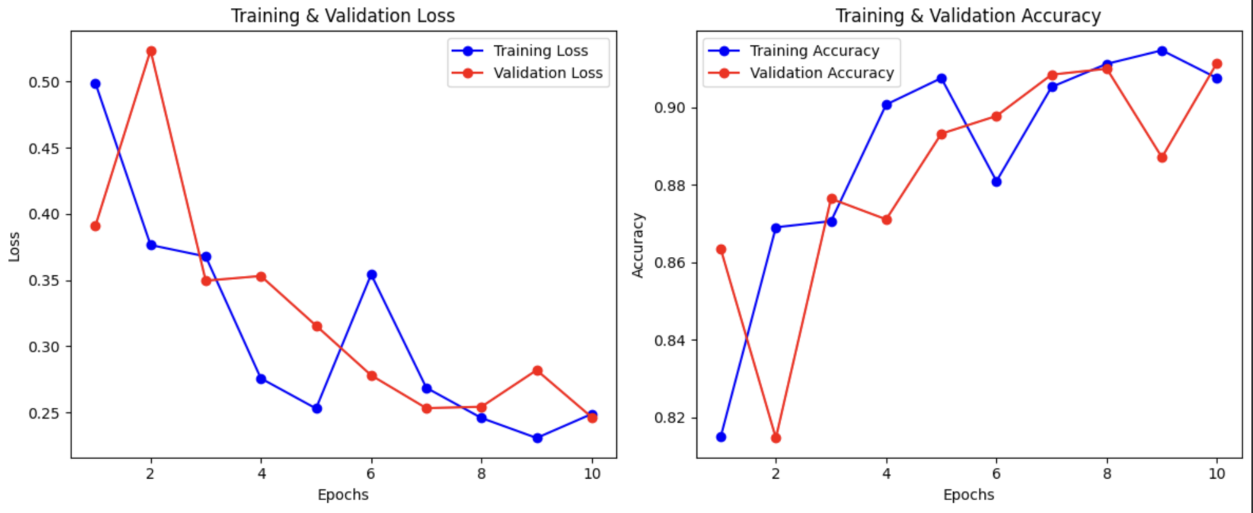
Results - Train and Validation
Training and Validation Dataset:
From Kaggle (7023 images)
ResNet-50 Training Hyperparameters:
Optimizer: SGD
Learning Rate: 0.01
Momentum: 0.9
Weight Decay: 1e-4
Loss Function: Cross-Entropy Loss
Trainable Parameters: Final Fully Connected Layer (resnet50.fc)
Number of Classes: 4
Epochs: 10
Training loss: 0.2488 Validation loss: 0.2463
Training accuracy: 90.76% Validation accuracy: 91.15%
Notes:
Here you can see the results of training tuned ResNet-50 model. The loss curves steadily decrease, and accuracy rises to around 90%, showing effective learning and strong generalization.

Slide 10
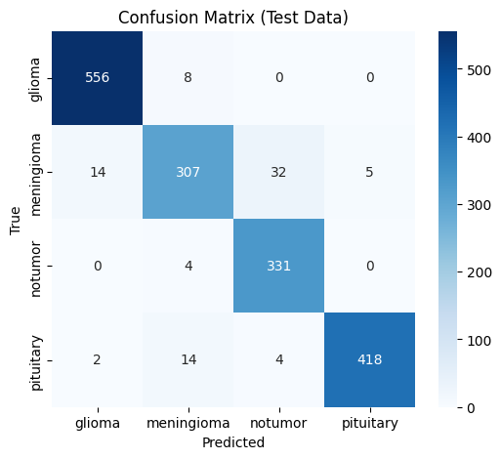
Results - Test
Testing Dataset:
From Roboflow (1695 images)
Observations:
Strong performance across all four tumor classes
Most errors between meningioma and similar tumor types (expected due to MRI visual overlap)
Some confusion also appears between no-tumor images and tumor cases (expected due to early-stage or small tumors)
Conclusion:
Reliable method for automated brain tumor classification
Test Accuracy: 95.10%
Notes:
Our model achieved a test accuracy of 95.10%. The confusion matrix demonstrates high correctness across all four tumor classes. Most errors occur between meningioma and other visually similar tumor types, which is expected due to overlapping MRI characteristics. Some confusion also appears between no-tumor images and tumor cases, which can be explained by early-stage or small tumors that are difficult to distinguish even for experts. Overall, these results show that the tuned ResNet-50 model provides a highly reliable method for automated brain tumor classification.

Slide 11
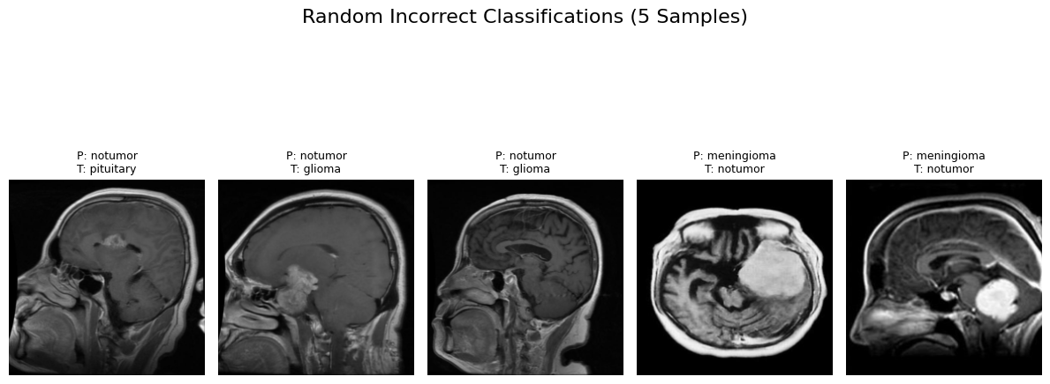
Results - Example of predicted labels
Notes:
Here you can see five incorrectly classified samples. These hard-to-distinguish images show where the model struggles and why the task is challenging.

Slide 12
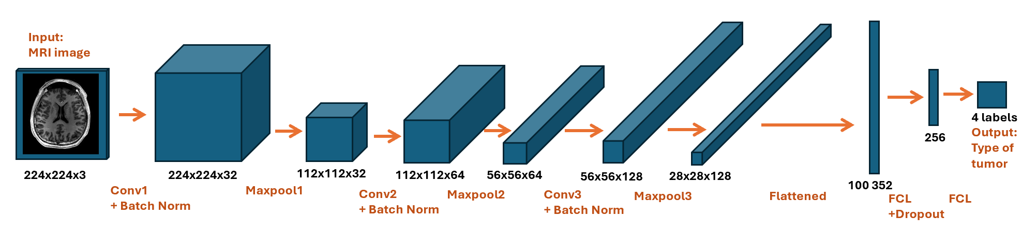
Results - Performance Comparison with Baseline Model
Baseline CNN
Simple CNN built from scratch for comparison
Three convolutional layers for basic feature extraction
Fully connected layers for classification
Dropout added to reduce overfitting
Predicts four brain tumor classes
Notes:
We built a simple CNN model to serve as a benchmark for ResNet-50.

Slide 13
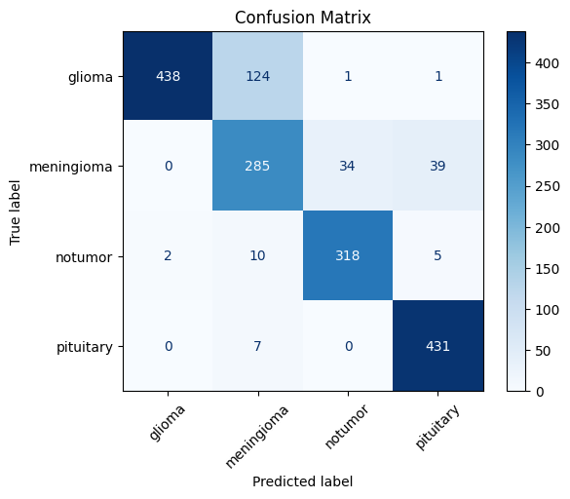
Results - Performance Comparison with Baseline Model
Baseline Model
Reasonable starting point
But significantly weaker performance than Transfer Learning
More frequent misclassifications compared to ResNet model
Accuracy: 86.84%
Notes:
The baseline model achieved 86.84% accuracy, but as seen in the confusion matrix, it shows more misclassifications and weaker performance, highlighting the limits of a simple architecture for this complex task.

Slide 14
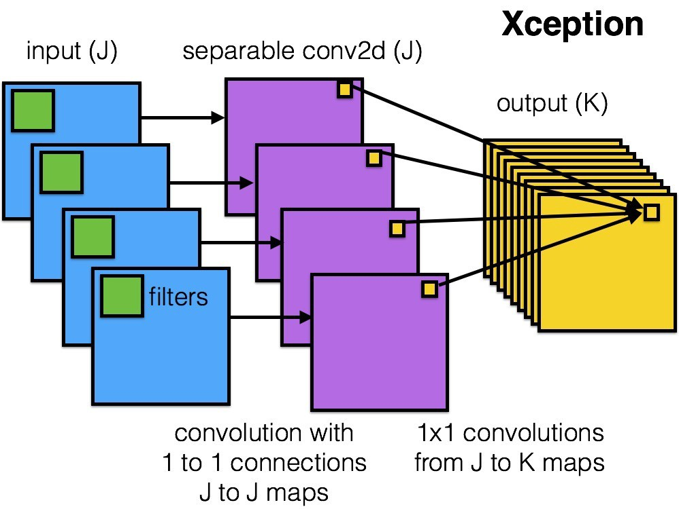
Results - Performance Comparison with Related Work
Xception Model (99.24%) from Kaggle
More advanced architecture
Higher input resolution
ResNet18 (99.69%) from Kaggle
More layers were fine-tuned
More training time (60 epochs)
Notes:
The dataset we used to train our model is widely used, so many high-performing models have already been built on top of it. To compare our results, we looked at two popular Kaggle models with accuracies around 99%. Their higher performance can be explained by factors such as more advanced architectures, larger input image sizes, deeper fine-tuning, and longer training.

Slide 15
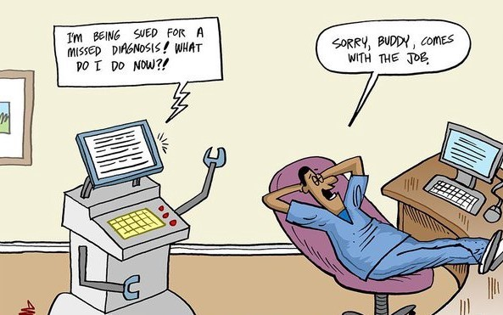
Discussion: Takeaways
Importance and convenience of transfer learning
Model limitations: low contrast, smaller tumours, data augmentation
Accuracy by class vs. overall
Training and testing using different data sources
Image Source
Notes:
Now we will discuss the takeaways of our work doing this project:
Importance and convenience of TL: faster training, strong initial feature extraction, effective while requiring less data to train than with a CNN from scratch
Model limitations:
low contrast and smaller tumors reduce detection accuracy increasing false classifications
Data not augmented, which could help improve robustness, but may excessively distort tumour features
Accuracy by class versus overall accuracy
Looking at results class by class, via measures such as the confusion matrix helped capture weaknesses that may not be represented by a single overall accuracy score alone
Kaggle dataset for training and Roboflow for testing
Training and testing on two different data sources helps evaluate the model on completely new data

Slide 16

Discussion: Ethics + Fairness
Transparency principle with using pre-trained networks (ResNet-50)
Interpretability of AI decisions in critical fields
Medical clinicians need clear reasoning behind their decisions
Should professionals using AI as a tool possess an understanding of it?
Doctor: Your MRI scans show a pituitary brain tumour.
Patient: Can you elaborate further on this diagnosis?
Doctor:
Adapted from Image source
Notes:
Finally I would like to touch on some ethics and fairness principles we’d like to consider reflecting on our work:
Transparency principle with pre-trained models:
Pre-trained networks improve results, but can hide the internal feature learning, leading to another issue of
Interpretability:
In the medical field, the reasoning behind a clinician's decision needs to be sound and reasonable.
Using AI in decision making processes using pre-trained models such as theResNet used in our project, it makes it harder for clinicians to have full confidence in their judgement , and know fully how decisions were made
Leads to the question : Should professionals using AI as a tool possess an understanding of it?

Slide 17
THANK YOU!

Slide 18
References
https://www.kaggle.com/code/yousefmohamed20/brain-tumor-mri-accuracy-99#2.3-Data-preprocessing
https://www.kaggle.com/code/abdocan/brain-tumor-classification-pytorch-99-7-test#Model-2-(ResNet18)
https://ca.indeed.com/career-advice/finding-a-job/how-to-become-a-radiologist?
https://www.uottawa.ca/faculty-medicine/radiology/residency
https://link.springer.com/article/10.1186/s13244-021-01031-4

